Slide 1


“All your (data)base are belong to us”
The rise of the empowered public
and the journalist-source relationship.
DAN PACHECO
Chair, Journalism Innovation

Slide 2
My background
Founding producer at Washingtonpost.com (1996).
Product management, AOL – community & social networking products. Also newspaper industry.
Chair Journalism Innovation at S.I. Newhouse School.
New tech for new media, entrepreneurial journalism.

Slide 3
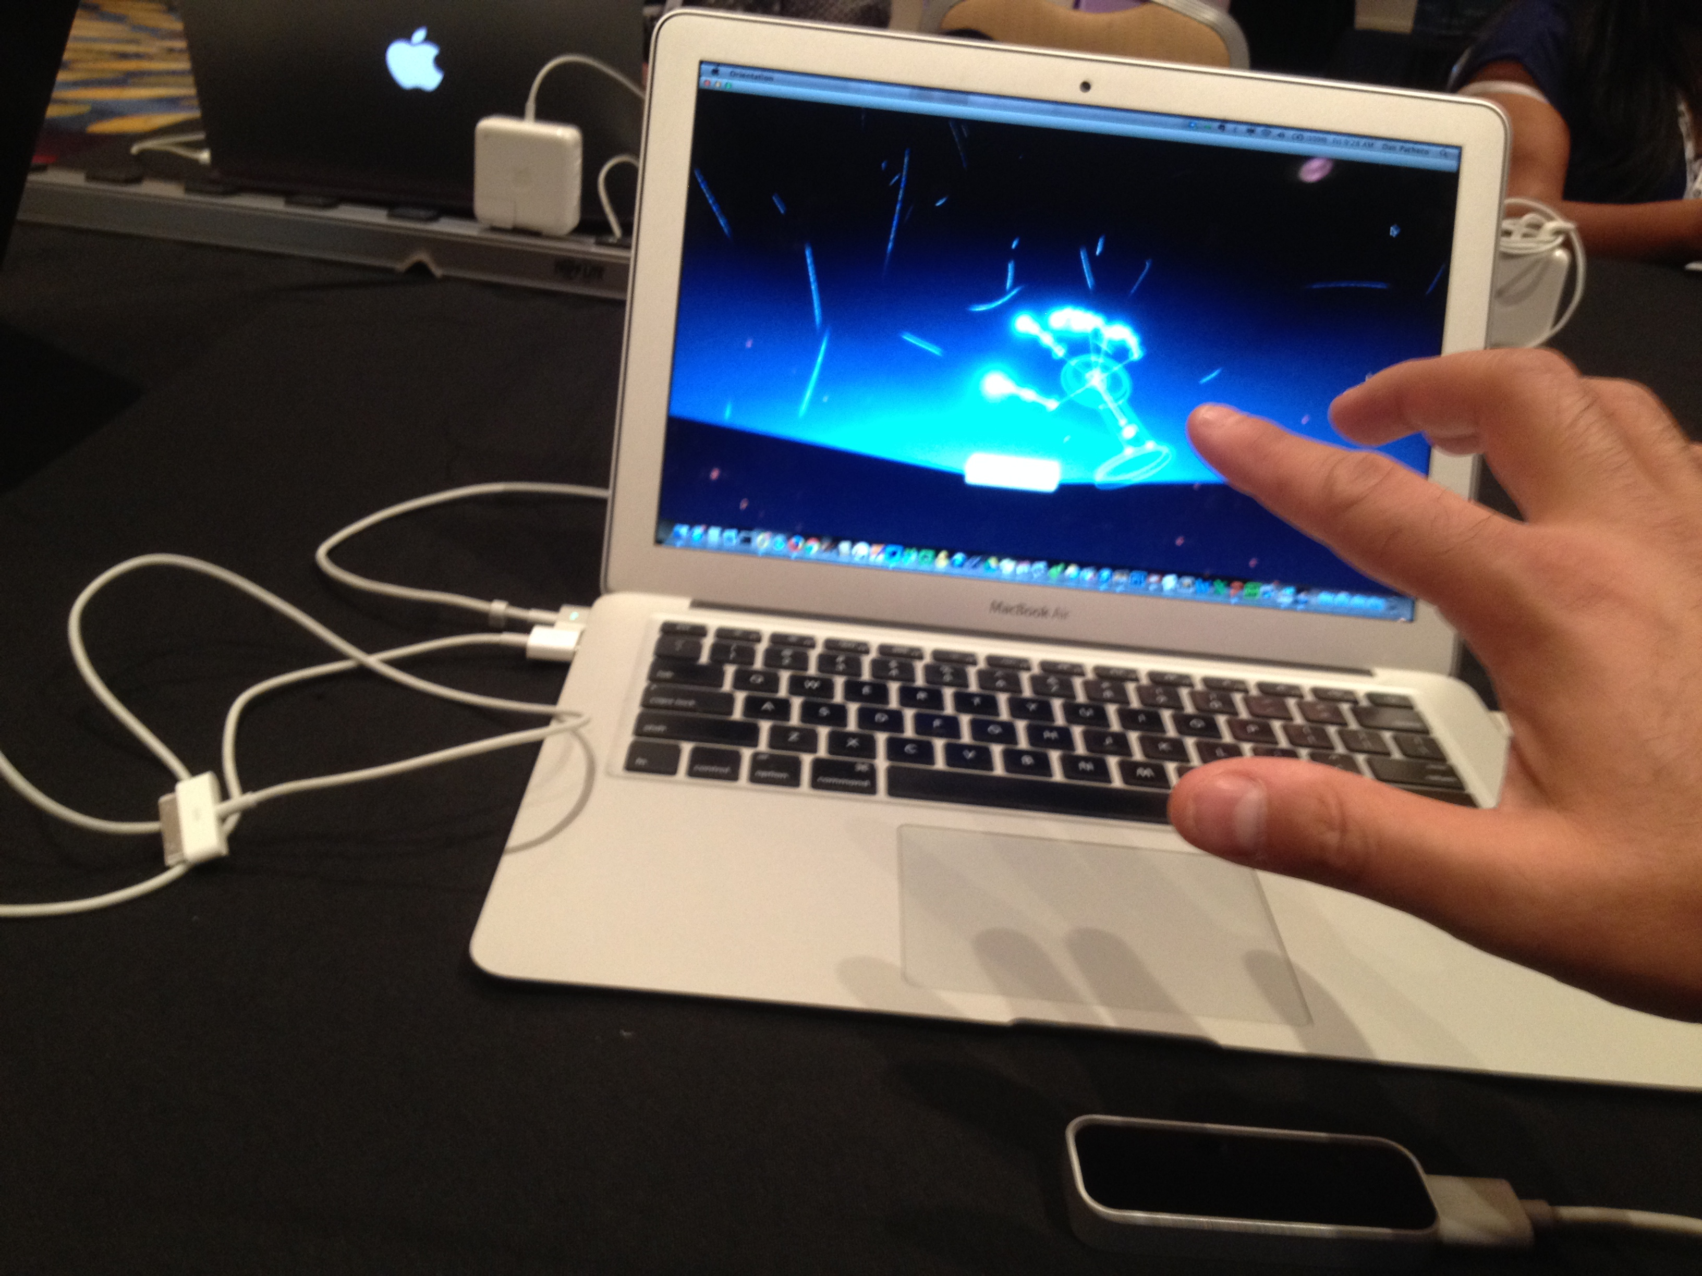

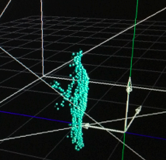
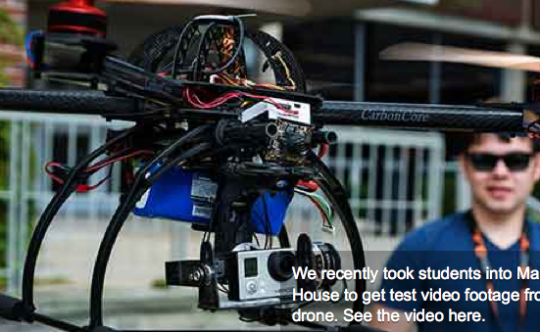
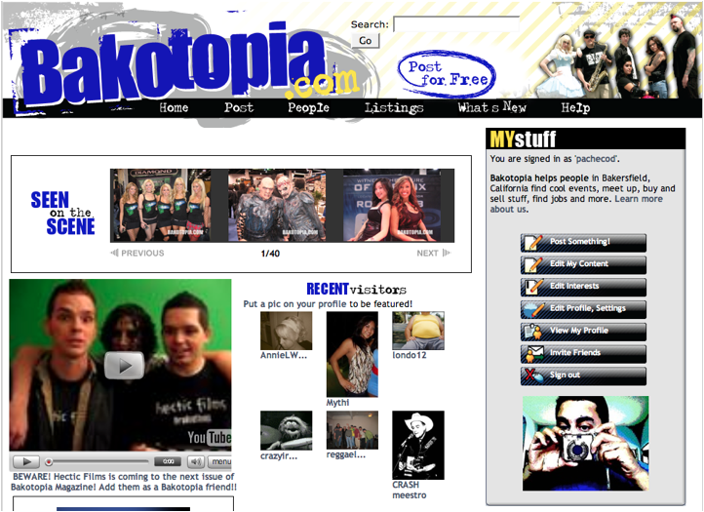
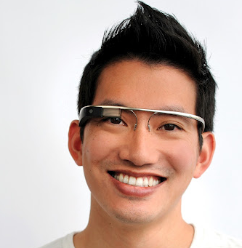
This is all my partly fault.
But what’s keeping me up at night?

Slide 4

3 months before Snowden leaks
Hacker groups starting “cryptoparties.”
The Guardian, others offer training, downloads for encryption, TOR for anonymous browsing, PGP for encrypted email.
“How to safely leak information to our newsroom.”

Slide 5
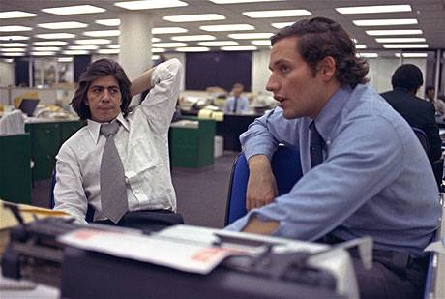
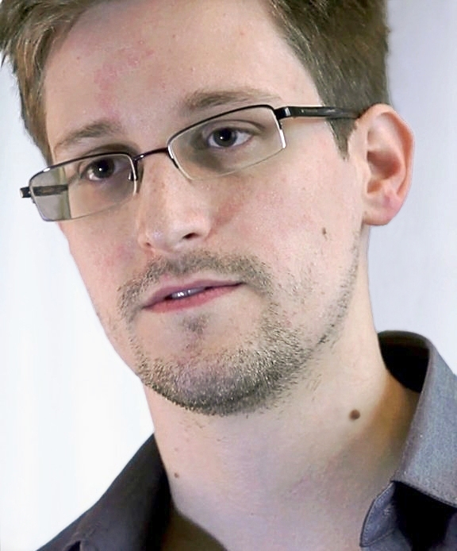
A Tale of Two Eras
1972 Watergate
2013 Edward Snowden

Slide 6
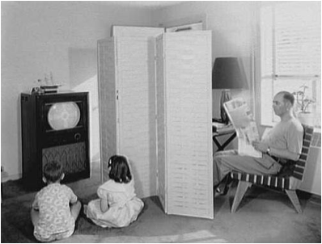
Then and now
Tidy and predictable!
Kids get their TV!
Dad gets his newspaper!
The “Leave it to Beaver” media model.

Slide 7

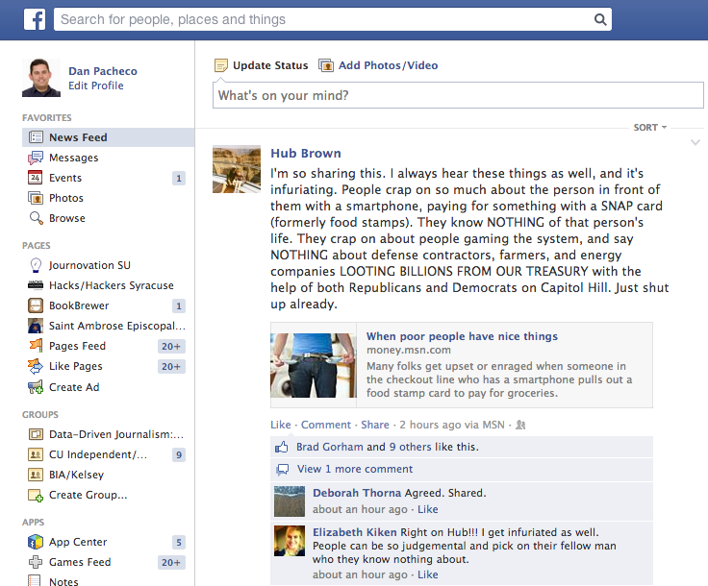
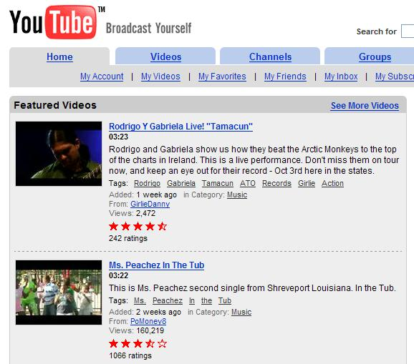
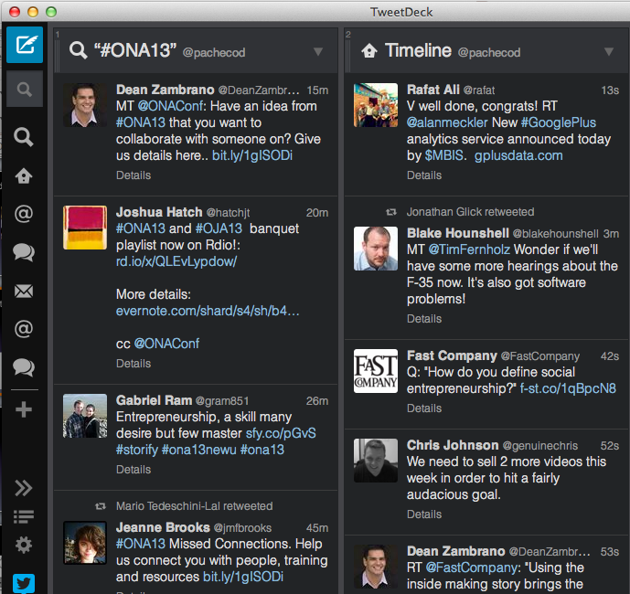
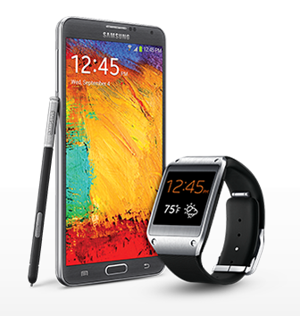
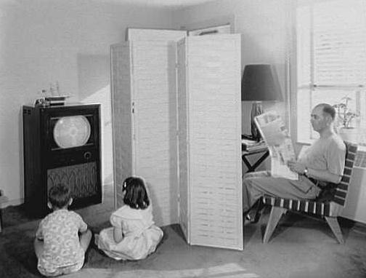
Reality: what a mess!
Notes:
7

Slide 8
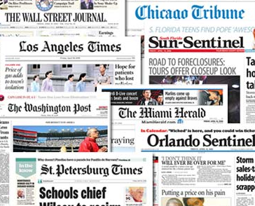
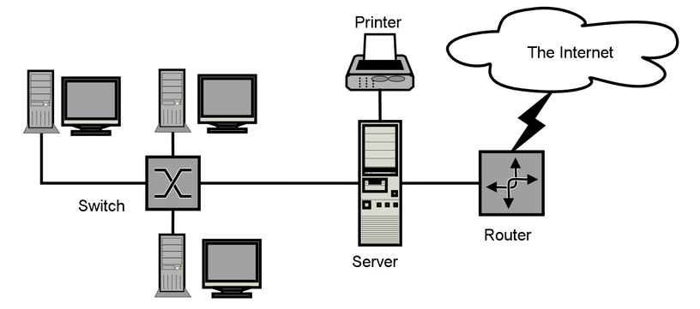
Legacy media got it wrong
“What a great delivery vehicle for our content!”

Slide 9
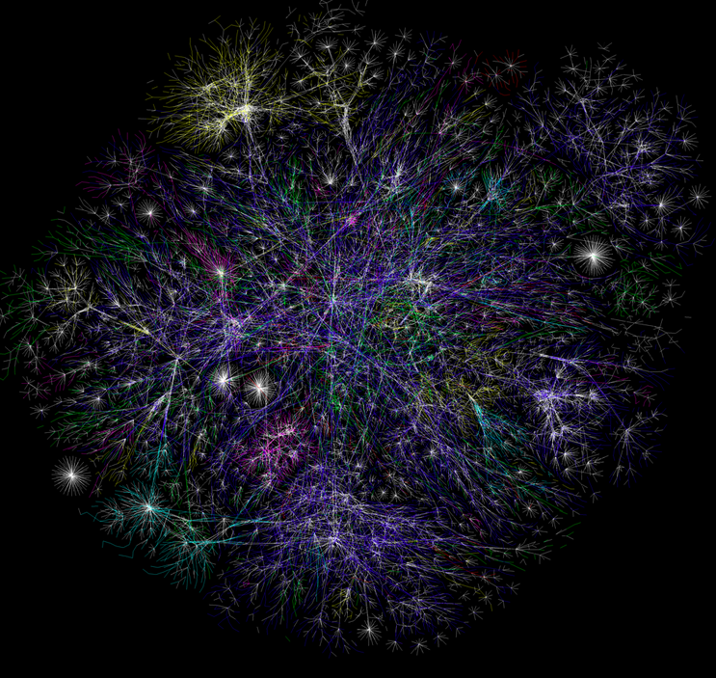
It’s a Network, stupid!
New story
News site
A tweet
An ad
Blog
Facebook page
News video
LOLCat
OPTE.org
OPTE.org

Slide 10
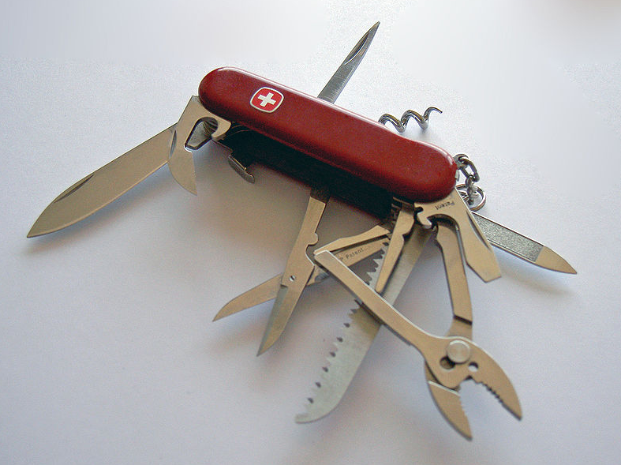
Comics
Local, national and global news
Coupons
The Daily Newspaper
Find a job
Car ads
Sports
Apartment listings
Share opinions
Delivered to you every day in one nice package!
Crosswords
Service directories
Source: WikiMedia Commons

Slide 11
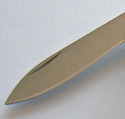





Share opinions: Twitter, Facebook, blogs
Local, national and global news
The Internet:
go get it for free!
Find a job: Craigslist
Service directories: Angie’s List, local discussion boards.
Comics: online, apps
Apartment listings: Craigslist

Slide 12
1972 Watergate
Gov
“The Public”
Journalists
Anon sources
Woodward & Bernstein
Journalist’s role: Digging, informing. The only source of all objective news.
Public trust of journalists: 70% confidence (Gallup).
Sources: Deep Throat remained anonymous for 30 years.

Slide 13
A relationship based on trust

Slide 14
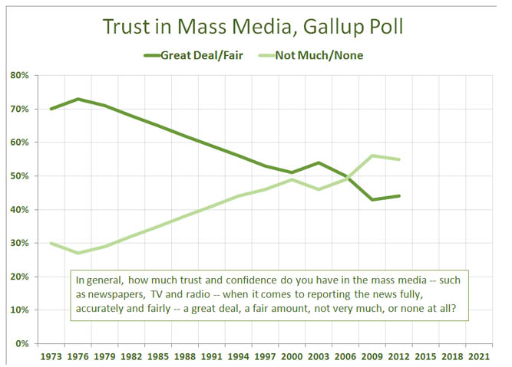
Oh, crap!
Source: PressThink, Jay Rosen - http://bit.ly/1bi9muD

Slide 15
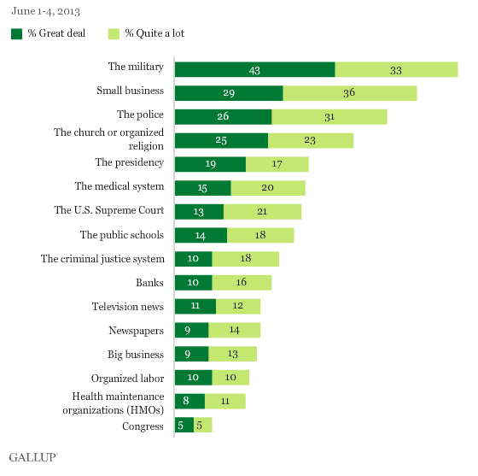
Confidence? Uh … no.

Slide 16
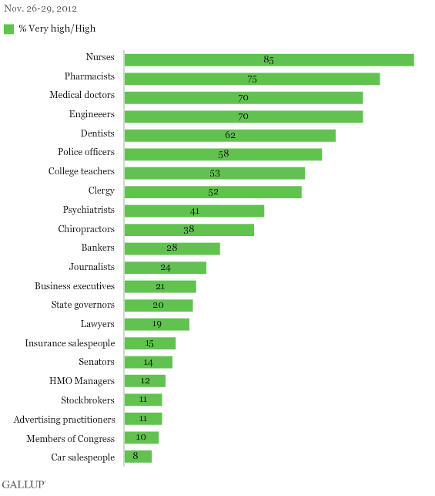
Honesty and ethics? NOT!

Slide 17
1994: Rise of the Consumer Internet
The Internet
Anyone can publish anything.
Most don’t – they just grab what media companies put out there.

Slide 18
Over the next decade …
2000 – 2004 Entirely new roles emerge
“The Social Public”
“Empowered
Public”
AIM chat
Facebook
MySpace
Twitter
Bloggers
Podcasters
“Hackers”
Media Startups
Craigslist
Mobile
Connecting, sharing,
AMPLIFYING
Creating content,
open source software, PUBLISHING & BUILDING

Slide 19
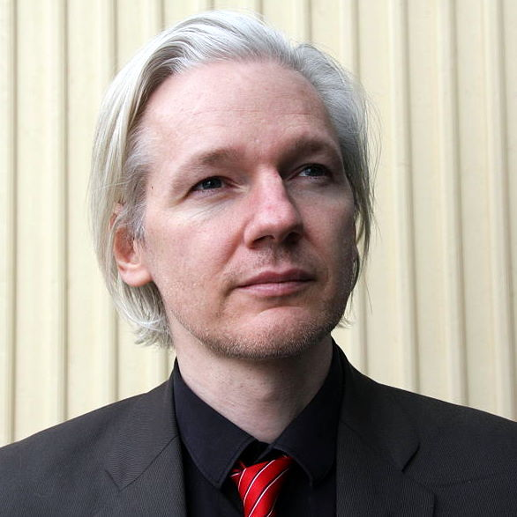
2006 Wikileaks
Journalists
SocialPublic
“The Internet”
Gov
Social networks
Anon Sources
Empowered Public (bloggers, hackers)
Sources go to the empowered public first.
Journalists amplify this new voice. DIFFERENT.

Slide 20
2006 Wikileaks
SocialPublic
Gov
Internet
J
Anon Sources
Empowered Public
Internet
Social networks
Journalist’s role: Reacting to what sources leak directly into the network. Analysis, context.
Public trust of journalists: Low (20% confidence). Sources begin to ignore the press and go directly to each other and some of the social public.
Empowered public: Annoyed at journalists (The Guardian) for publishing encryption keys.

Slide 21
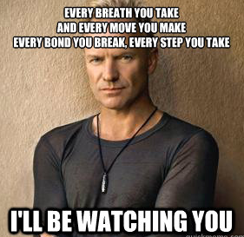
2013 Snowden
Gov surveillance
Internet
Gov
J
Anon
Sources
Social Public
Empowered Public (hackers)
Social networks
Gov networks
Gov surveillance
“The Sting doctrine”

Slide 22
2013 Snowden
Gov surveillance
Internet
Gov
J
Anon
Sources
Social Public
Empowered Public
Gov surveillance
Empowered Public: Strong overlap with government sources, especially when technology is involved.
Journalist’s role: Reacting to what sources leak into the network. Analyzing it and providing context. Followup.
Government’s role: Loses control of information when, ironically, it is also surveiling everything –calls, internet searches, social media, email, connections between people.

Slide 23
Changing Roles
1972
2013
Leaking
Anon source
Sources + empowered public
(including double agents!)
Digging
Journalist
Empowered public 1st, + journalists 2nd
Reporting
Journalists
Journalists + empowered public (equal)
Amplifying
(N/A)
Social public, esp. Twitter
Analysis
Journalists
Journalists + empowered public (equal)

Slide 24
The empowered public, not “social media,” is uncovering and even reporting the stories that matter most.

Slide 25
Question
Why did Snowden go to The Guardian and New York Times, rather than directly to the social public?
  I asked The Guardian. The answer: “He was very patriotic. He felt he wasn’t qualified to make judgments on what was happening. He just thought it was wrong.” (Janine Gibson, editor in chief of Guardian U.S. at Online News Association.”
Opportunity for journalists to regain the public’s trust.

Slide 26
A likely future
“Stingnet”
“Safenet”
Social Public
Gov
Encryption
Tor
Empowered Public
J
PGP
Anon
Sources

Slide 27
And Beyond
The social public is poised to emerge as a primary source / watchdog of government.
Get read for the Arab Spring on steroids.
Everyone becomes a camera. “Google Glass is a broadcast tower on your face.”

Slide 28
THANKS!
Dan Pacheco
Chair of Journalism Innovation
drpachec@syr.edu
Journovation.syr.edu
@pachecod & @JournovationSU

